Slide 1
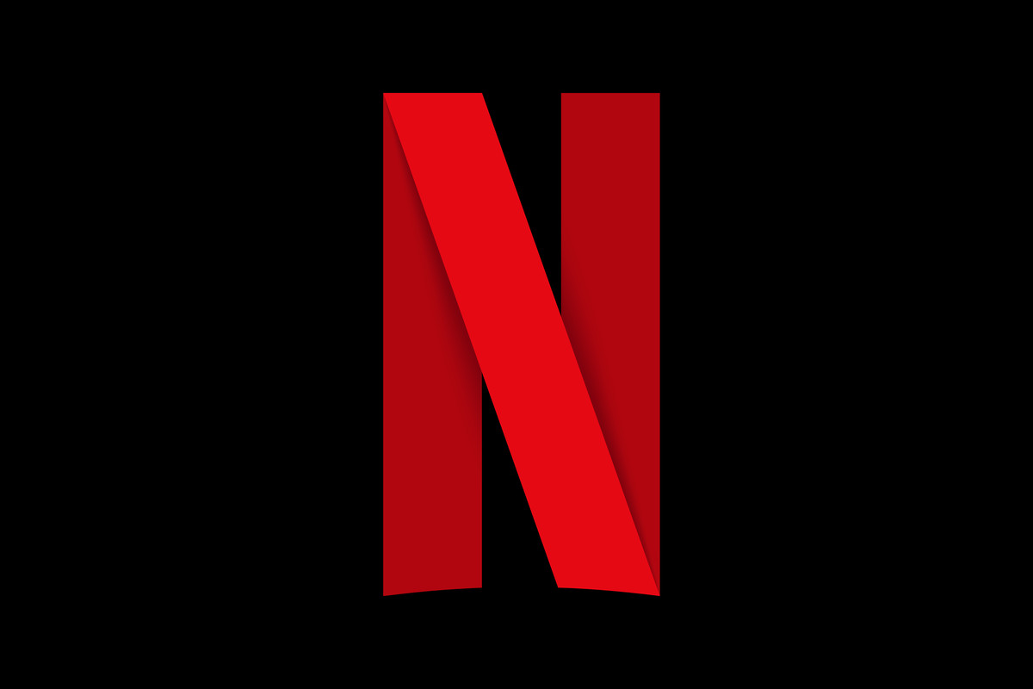
Netflix Original Movies
Analyzing IMDB Ratings of
Netflix Original Movies
From 2014 to June 1st, 2021

Slide 2



Notes:
Netflix has produced 584 Original Films from 2014, when it began making original films to June 1st, 2021. Not all films can become box offices hits such as the Godfather or Casablanca, and the IMDB scores of all these hundreds of Netflix films show that that is definitely the case.

Slide 3
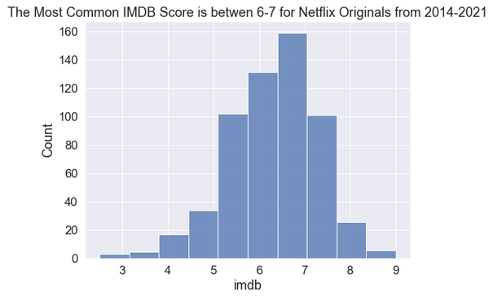
Average IMDB Score: 6.27
Notes:
The cumulative average IMDB score of all Netflix’s original films is 6.27.
But why did they get that score? What movies brought their score down and for what reason? On the other hand, what movies did well bringing up their average score?

Slide 4

Best IMDB Rated Film with a 9.0:
Title: David Attenborough: A Life on Our
Planet
Genre: Documentary
Length: 83 Minutes
Language: English
Release Date: 2020-10-04
Notes:
Here we have Netflix’s best IMDB rated original film with a score of 9.0.

Slide 5

Worst IMDB Rated Film with a 2.5:
Title: Enter the Anime
Genre: Documentary
Length: 58 Minutes
Language: English/Japanese
Release Date: 2019-08-05
Notes:
And here we have the worst IMDB rated film with a score of 2.5.
But what are the major differences? Do reasons such as genre, length, language or release date affect the IMDB rating of their films?

Slide 6
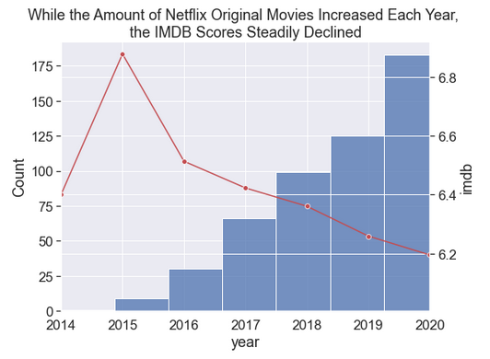
Has the Quality of Netflix Movies Declined Over the Years?
Notes:
The quality of Netflix Movies, on average, has gone down over the years.
As shown by the line graph, the average IMDB rating has been on a consistent decline since their peak average performance in 2015.
Starting in 2015 with an average IMDB rating above 6.8, it declines to a 6.2 rating during 2020. On the other hand, the number of films produced by Netflix increased dramatically, with less than 10 produced in 2015 to more than 175 in 2020.

Slide 7
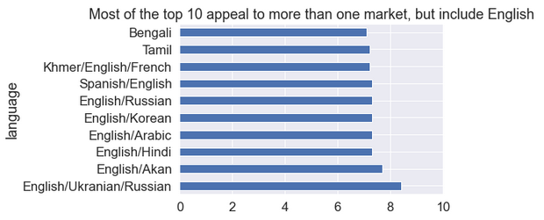
Is there a specific Market that gets higher rating than the rest?
Notes:
Is there a specific market or language that tends to get higher ratings?
As you can see by the chart of the top 10 languages for films with the highest IMDB averages, almost all of them are localized for different areas, reaching more people. And note that this chart does not start at a And you can also see that most all of them also contain English.

Slide 8
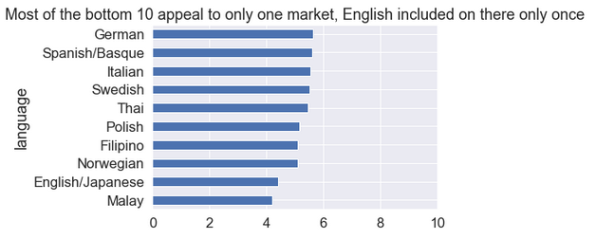
Bottom 10 Markets
Notes:
In a direct contrast, most of the worst rated films are localized to these only one specific language. Note that English is only on here once.

Slide 9
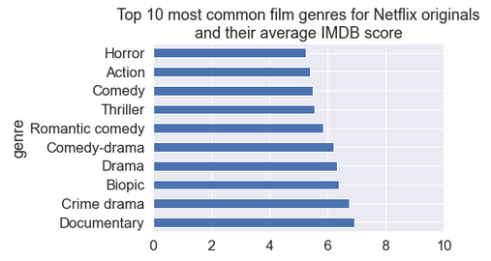
Does genre affect the IMDB score?
Notes:
Genre does seem to have an effect on the score. Charted are the top 10 most common film genres for all Netflix Originals and their relative average IMDB score.
Documentaries, with a total of 159 movies has the highest average out of the most popular genres listed with about an average score of 7.
Comedy, with a total of 49 films, was much lower on the list with a sub 6 score.

Slide 10
What can we take away from this?
Queen Tour Film
Genre: Concert Film
Runtime: 110 Minutes
Language: English/Japanese
Premiere: 2022-06-18
IMDB: ?
?
Notes:
From this we can have a general idea of a gauge on how a film will do. We can create a model/ai to train on this data and predict on new films with these same criteria. We can take the trends we discovered and predict on films with their own criteria.

Slide 11
Where can we go from here?
Checking Directors for their influence
Filming budget
Promotional budget
Actors/Actresses
Does it compare to aggregate scores of other sites

